Slide 1
Quantum Search Algorithms
Seminar 5

Slide 2
Before Going in…
Shor’s Algorithm was devised in 1994.
The Quantum Search Algorithm, or Grover’s Algorithm, was devised in 1996.
Yeah..pretty contemporary stuff! You know what this means then!

Slide 3
Before Going in…
What is Quantum Search Algorithm anyway?
Suppose you are given a map containing many cities, and wish to determine the shortest route passing through all cities on the map.
Brute Force: Just Draw it all!

Slide 4

Before Going in…
When the whole graph has N routes, it is obvious that the whole algorithm will require O(N) operations.
For Quantum Computers, surprisingly, this is viable in $O(\sqrt{N})$ operations!
Can we do better than $O(\sqrt{N})$?

Slide 5

The Oracle
Suppose we wish to search through N elements.
Make indices of those form 1 to N: when $N=2^{n}$, n bits will suffice.
Assume the search algorithm has M solutions:
Define a function f: If x is a solution for the search algorithm, f(x)=1. Else, f(x)=0.

Slide 6


The Oracle
Quantum Oracle: A Black Box with the ability to recognise solutions to the search problem.
How the oracle functions is a later topic.
How does the oracle ‘recognise’? : Oracle Qubit $\left|\left.q\right\rangle \right.$

Slide 7

Hadamard Transform
Quiz. Apply the oracle transformation at $\frac{\left|\left.0\right\rangle \right.−\left|\left.1\right\rangle \right.}{\sqrt{2}}$.
Ans.$\left|\left.x\right\rangle \right.\frac{\left|\left.0\right\rangle \right.−\left|\left.1\right\rangle \right.}{\sqrt{2}}→{(−1)}^{f(x)}\left|\left.x\right\rangle \right.\frac{\left|\left.0\right\rangle \right.−\left|\left.1\right\rangle \right.}{\sqrt{2}}$
Note that the oracle qubit DOES NOT change during the process.
Simplification: $\left|\left.x\right\rangle \right.→{(−1)}^{f(x)}\left|\left.x\right\rangle \right.$
The oracle marks the solutions to the search problem.

Slide 8

Does the Oracle already know the solution?
Knowing and Recognising solutions are different subjects.
Example. Factorisation of m
Set the oracle to divide m by x if the state $\left|\left.x\right\rangle \right.$ comes as the input. If possible, flip the qubit.
f: 1 if x divides m, 0 if not.
Then, construct a circuit that makes $\left|\left.q\right\rangle \right.→\left|\left.q⊕f(x)\right\rangle \right.$
We know that we construct the relevant quantum circuits.

Slide 9

Prerequisite Procedures
First, apply the Hadamard Transform to make the equal superposition state $\frac{1}{\sqrt{N}}\sum_{x=0}^{N−1}{\left|\left.x\right\rangle \right.}$.
From here, the search algorithm is consisted of a routine operation called as the Grover Iteration.

Slide 10

Grover Iteration
Grover Iteration consists of Four steps.
1. Apply the Oracle O.
2. Apply the Hadamard Transform.
3. Apply a conditional phase shift: if $\left|\left.0\right\rangle \right.$, the state remains the same. For non-zero x, $\left|\left.x\right\rangle \right.$ is transformed to $−\left|\left.x\right\rangle \right.$.
4. Apply the Hadamard Transform again.

Slide 11
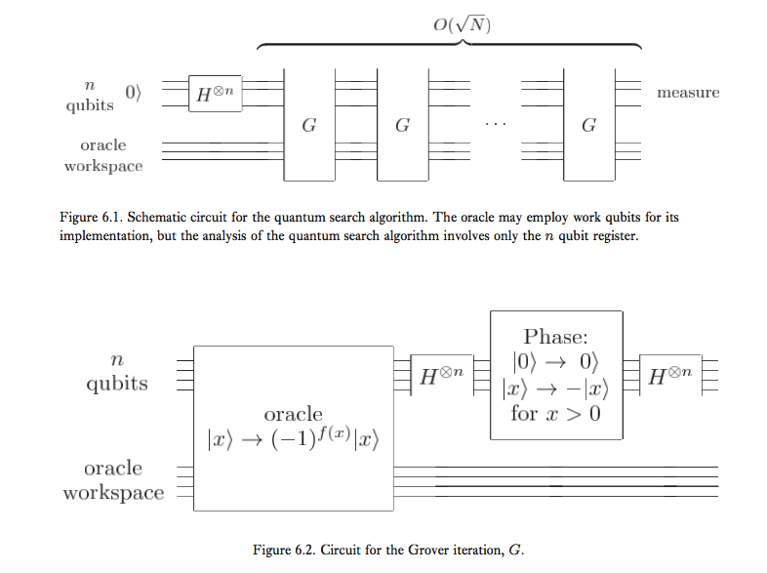
Schematic Diagram

Slide 12
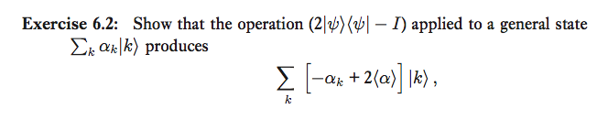

Further Explanations
Hadamard Transforms can be done with O(log n) gates.
Conditional Transforms can be done with O(n) gates.
The gates required for the oracle will differ by the search required.
The whole process can be written as $H^{⨂n}\left(2\left|\left.0\right\rangle \left\langle \left.0\right|−I\right.\right.\right)H^{⨂n}O=\left(2\left|\left.ψ\right\rangle \left\langle \left.ψ\right|−I\right.\right.\right)O$. ($\left|\left.ψ\right\rangle \right.$ is the equal superposition state.)
Quiz.

Slide 13

Geometric Visualisation
Question: What does the Grover Iteration do?
Define $\left|\left.α\right\rangle \right.=\frac{1}{\sqrt{N−M}}\sum{′′\left|\left.x\right\rangle \right.}$, $\left|\left.β\right\rangle \right.=\frac{1}{\sqrt{M}}\sum{′\left|\left.x\right\rangle \right.}$, meaning that the first ket is an equal superposition of states that are NOT solutions, and the second ket is a superposition of states that ARE solutions.
$\left|\left.ψ\right\rangle \right.=\sqrt{\frac{N−M}{N}}\left|\left.α\right\rangle \right.+\sqrt{\frac{M}{N}}\left|\left.β\right\rangle \right.$ : The initial state is spanned by $\left|\left.α\right\rangle \right.$ and $\left|\left.β\right\rangle \right.$.

Slide 14

Geometric Visualisation
Oracle’s Role: Reflection by the $\left|\left.α\right\rangle \right.$-axis
$2\left|\left.ψ\right\rangle \left\langle \left.ψ\right|−I\right.\right.$’s Role: Reflection by $\left|\left.ψ\right\rangle \right.$
Set $cos\frac{θ}{2}=\sqrt{\frac{N−M}{N}}$: $G\left|\left.ψ\right\rangle \right.=cos\frac{3θ}{2}\left|\left.α\right\rangle \right.+sin\frac{3θ}{2}\left|\left.β\right\rangle \right.$.
Obviously, $G^{k}\left|\left.ψ\right\rangle \right.=cos\frac{(2k+1)θ}{2}\left|\left.α\right\rangle \right.+sin\frac{(2k+1)θ}{2}\left|\left.β\right\rangle \right.$.

Slide 15
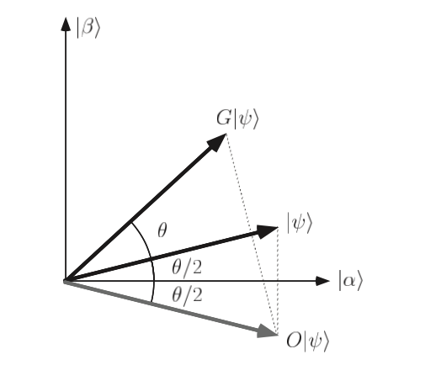

Summary
Grover Iteration is an operation that ROTATES the state ket by $θ$ on a 2D space spanned by $\left|\left.α\right\rangle \right.$ and $\left|\left.β\right\rangle \right.$.
If applied repeatedly, the state ket will eventually be close to $\left|\left.β\right\rangle \right.$.

Slide 16

Performance
How many iterations shall we need?
$\left|\left.ψ\right\rangle \right.=\sqrt{\frac{N−M}{N}}\left|\left.α\right\rangle \right.+\sqrt{\frac{M}{N}}\left|\left.β\right\rangle \right.$: we must rotate arccos$\sqrt{\frac{M}{N}}$ radians to reach $\left|\left.β\right\rangle \right.$.
CI(x): integer closest to x
$R=CI(\frac{\arccos{\sqrt{\frac{M}{N}}}}{θ})$ iterations rotates |ψ⟩ to within an angle θ/2 ≤ π/4 of |β⟩.

Slide 17

Performance
If M<<N: $θ≈sinθ≈2\sqrt{\frac{M}{N}}$: The angular error is at most $\frac{θ}{2}=\sqrt{\frac{M}{N}}$.
General Case: $R=CI(\frac{\arccos{\sqrt{\frac{M}{N}}}}{θ})$ -> Lower limit of theta means upper limit of R
$\frac{θ}{2}≥sin\frac{θ}{2}=\sqrt{\frac{M}{N}}$: $R≤\left\lceil \frac{π}{4}\sqrt{\frac{M}{N}}\right\rceil$ : Total number of operations is O($\sqrt{\frac{M}{N}}$).

Slide 18
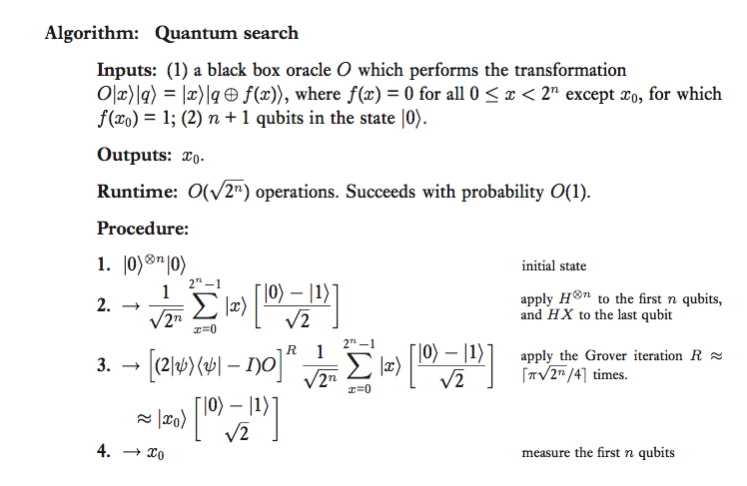
Summary

Slide 19

Caveats
Okay… what if M is larger or equal to N/2? Then we don’t have direct evidence that G will rotate the state close enough to $\left|\left.β\right\rangle \right.$.
If it is known that M > N/2: Just pick any element and test it. The success rate is more than ½.
If it is unknown: double the number of elements in the search space by adding N extra items to the search space, none of which are solutions. (i.e. add another qubit to the search index.)

Slide 20

‘Deriving’ the Quantum Search Algorithm
Okay..we did this, but how the f*** can we think of it?
For the sake of simplicity, let’s assume there is just one solution to the search algorithm problem: $\left|\left.x\right\rangle \right.$
Step 1. Think of a Hamiltonian that depends on $\left|\left.ψ\right\rangle \right.$ and $\left|\left.x\right\rangle \right.$, and after some prescribed time, $\left|\left.ψ\right\rangle \right.$ evolves to $\left|\left.x\right\rangle \right.$.
Step 2. Simulate this whole action using the Quantum Simulation Algorithm.

Slide 21

The Hamiltonian
Simple viable solutions: H = |x⟩⟨x| + |ψ⟩⟨ψ| or H = |x⟩⟨ψ| + |ψ⟩⟨x|. (Actually, both turn out to be solutions!)
Time evolution: $e^{−iHt}\left|\left.ψ\right\rangle \right.≈\left(1−iHt\right)\left|\left.ψ\right\rangle \right.=\left(1−it\right)\left|\left.ψ\right\rangle \right.−it\left\langle x | ψ\right\rangle \left|\left.x\right\rangle \right.$
OMG! The $\left|\left.ψ\right\rangle \right.$ vector is now slightly rotated closer to $\left|\left.x\right\rangle \right.$ axis! Can we make this closer?

Slide 22

The Hamiltonian
Orthogonal Bases |x⟩ and |y⟩
$\left|\left.ψ\right\rangle \right.=α\left|\left.x\right\rangle \right.+β\left|\left.y\right\rangle \right.$
Then, $H=\left[\begin{matrix}1 & 0 \\ 0 & 0\end{matrix}\right]+\left[\begin{matrix}α^{2} & αβ \\ βα & β^{2}\end{matrix}\right]=\left[\begin{matrix}1+α^{2} & αβ \\ βα & 1−α^{2}\end{matrix}\right]=I+α(βX+αZ)$
$e^{−iHt}\left|\left.ψ\right\rangle \right.=e^{−it}(\cos\left(αt\right)\left|\left.ψ\right\rangle \right.−isin\left(αt\right)\left(βX+αZ\right)\left|\left.ψ\right\rangle \right.)$
Note $(βX+αZ)\left|\left.ψ\right\rangle \right.=\left|\left.x\right\rangle \right.$
$e^{−iHt}\left|\left.ψ\right\rangle \right.=e^{−it}(\cos\left(αt\right)\left|\left.ψ\right\rangle \right.−isin\left(αt\right)\left|\left.x\right\rangle \right.)$

Slide 23

Analysis
$e^{−iHt}\left|\left.ψ\right\rangle \right.=e^{−it}(\cos\left(αt\right)\left|\left.ψ\right\rangle \right.−isin\left(αt\right)\left|\left.x\right\rangle \right.)$: When $t=\frac{π}{2α}$, we can get $\left|\left.x\right\rangle \right.$ with probability 1!
Problem: $α$ depends on $\left|\left.x\right\rangle \right.$.
Solution: make $\left|\left.ψ\right\rangle \right.=\frac{1}{\sqrt{N}}\sum_{x}{\left|\left.x\right\rangle \right.}$ -> by this way, $α$ is the same regardless of the state ket.

Slide 24
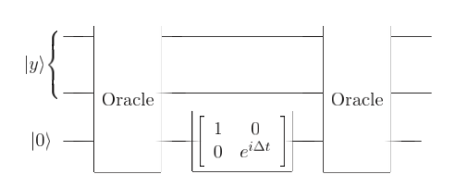
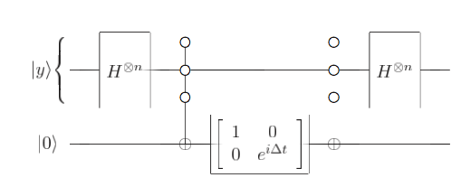

Realisations as Quantum Circuits
We know the algorithm – let’s make it into a Quantum Circuit!
How do we simulate the Hamiltonians |x⟩⟨x| and |ψ⟩⟨ψ| ? (To be specific, $e^{−i(\left|\left.x\right\rangle \right.\left\langle \left.x\right|\right.Δt)}$ and $e^{−i(\left|\left.ψ\right\rangle \right.\left\langle \left.ψ\right|\right.Δt)}$)

Slide 25

Links with the Search Algorithm
What if $Δt=π$?
Compare the result with the Grover Iteration:
Caveat. Brute-Application gives usually gives O(N) (No better than the classical search algorithm.). Actually, $Δt=π$ is a special case and gives O($\sqrt{N}$) oracles to be used!

Slide 26
Quantum Counting
How do we determine the number of solutions in a Quantum Search problem?
Classical: O(N) (Obviously.)
How do we do it in Quantum?
Spoiler Alert: We use Phase Estimation.

Slide 27

The Basics
Suppose |a⟩ and |b⟩ are the two eigenvectors of the Grover iteration in the space spanned by |α⟩ and |β⟩.
Let θ be the angle of rotation determined by the Grover iteration.
Little calculation shows that the eigenvalues are $e^{iθ}, e^{i(2π−θ)}$.
GOAL: Assume augmented oracle: $\sin^{2}\frac{θ}{2}=\frac{M}{2N}$ . Then, estimating theta in a reasonable amount of accuracy shall suffice.

Slide 28
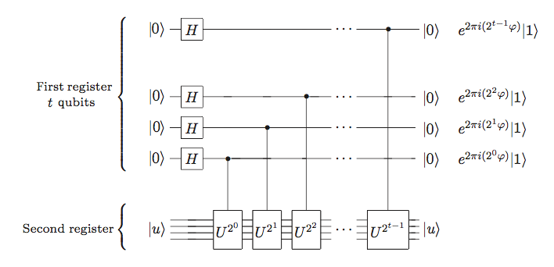
Recall

Slide 29
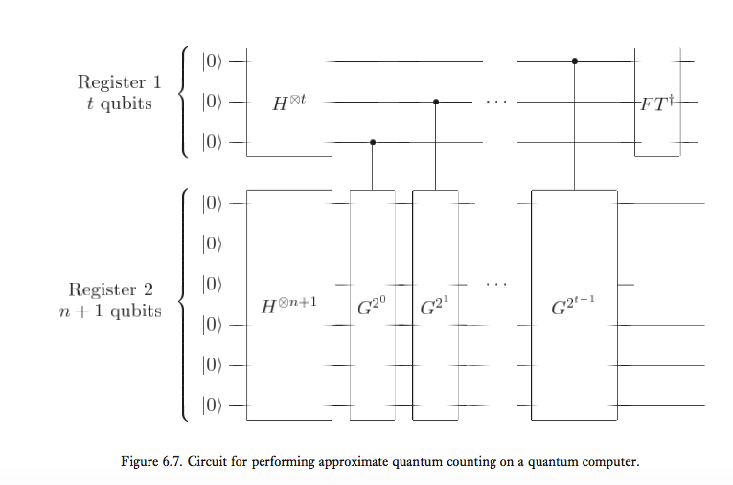

Approximate Quantum Counting Algorithm
Note. $t=m+log(2+\frac{1}{2ε})$

Slide 30

Estimation of Error
Our discussion of this topic last seminar reveals that this circuit can estimate $θ$ or $2π−θ$ with an error of $2^{−m}$ with an accuracy of $1−ε$.
How much does this give on error of M?
$\frac{\left|ΔM\right|}{2N}=\left|\sin^{2}\frac{θ+Δθ}{2}−\sin^{2}\frac{θ}{2}\right|$
Simple calculation gives $\frac{\left|ΔM\right|}{2N}<(2sin\frac{θ}{2}+\frac{\left|Δθ\right|}{2})\frac{\left|Δθ\right|}{2}$ or
$\left|ΔM\right|<(\sqrt{2MN}+\frac{N}{2^{m+1}})2^{−m}$

Slide 31

Speeding up NP-complete problems
Example. Hamiltonian Cycles (HC): A simple cycle which visits every vertex of the graph.
How to solve: 1. Label the vertices. (Repetition ALLOWED)
2. Check each ordering to see whether it is the solution. (Simple and clear, isn’t it?)
Total: $n^{n}=2^{nlogn}$ processes.
Solving NP problems are similar to this: if a problem of size n has witnesses which can be specified using w(n) (Polynomial) bits, then searching through all $2^{w(n)}$possible witnesses will suffice.

Slide 32

The Quantum-Way
I won’t go in details. Just think that we construct the oracle accordingly, and perform the search algorithm.
Normally, the quantum way requires $p(n)2^{nlogn/2}$ operations. This is roughly the square root of the classical algorithm if viewed asymptotically.
P(n) emerges because constructing oracle requires operations.

Slide 33

Search in an Unstructured Database
How do we find Chrysanthemum in a database that contains 10,000 flowers?
Suppose we have a database containing $N ≡ 2^{n}$items, each of length l bits. We will label these items $d_{1}, d_{2}…, d_{N}$.
CPU: Stores small amount of information, data manipulation takes place.
Memory: Stores the database, PASSIVE storage.

Slide 34
Classical Algorithm
Rather brute force…
Set an n-bit index. The CPU must be able to store this information.
We compare it one-by-one: 1. The database entry corresponding to the index is loaded.
2. Compare to the string we want to search.
3. Match -> Output the value and Halt. No Match -> value increases.

Slide 35
The ‘Quantum’ CPU
CPU is consisted of 4 registers;
(1) an n qubit ‘index’ register initialized to |0⟩;
(2) an l qubit register initialized to |s⟩ and remaining in that state for the entire computation;
(3) an l qubit ‘data’ register initialized to |0⟩;
and (4) a 1 qubit register initialized to (|0⟩ − |1⟩)/√2.

Slide 36

‘Quantum’ Memory
Two ways of Implementation:
1. Quantum memory containing all the information, and $\left|\left.d_{x}\right\rangle \right.$ as the entries.
2. Use classical memory. However, it can be addressed by an index x which can be in a superposition of MULTIPLE values.
Therefore, a superposition of values can be loaded!

Slide 37

The Oracle
Loading: the CPU’s index register is in the state |x⟩ and the data register is in the state |d⟩.
then the contents $d_{x}$ of the xth memory cell are added to the data register: |d⟩ → |d ⊕ $d_{x}$⟩.
What the oracle must do: flip the phase when it is the answer!
Assume starting at $\left|\left.x\right\rangle \right.\left|\left.s\right\rangle \right.\left|\left.0\right\rangle \right.\frac{\left|\left.0\right\rangle \right.−\left|\left.1\right\rangle \right.}{\sqrt{2}}$.

Slide 38

The Oracle
Then, the CPU loads the data: $\left|\left.x\right\rangle \right.\left|\left.s\right\rangle \right.\left|\left.d_{x}\right\rangle \right.\frac{\left|\left.0\right\rangle \right.−\left|\left.1\right\rangle \right.}{\sqrt{2}}$
The Second and Third registers are compared. If same, return $−\left|\left.x\right\rangle \right.\left|\left.s\right\rangle \right.\left|\left.d_{x}\right\rangle \right.\frac{\left|\left.0\right\rangle \right.−\left|\left.1\right\rangle \right.}{\sqrt{2}}$ and if different, $\left|\left.x\right\rangle \right.\left|\left.s\right\rangle \right.\left|\left.d_{x}\right\rangle \right.\frac{\left|\left.0\right\rangle \right.−\left|\left.1\right\rangle \right.}{\sqrt{2}}$.
Finally, load the data again. This will make the state to be $\left|\left.x\right\rangle \right.\left|\left.s\right\rangle \right.\left|\left.0\right\rangle \right.\frac{\left|\left.0\right\rangle \right.−\left|\left.1\right\rangle \right.}{\sqrt{2}}$ once again.

Slide 39

Some Analysis
By our results in Quantum Search Algorithms, we require $O\left(\sqrt{N}\right)$ operations of loading, instead of O(N) in classical.
Can the memory be implemented classically? Answer: Yes, but with some limitations. This is referred as the Quantum Addressing Scheme. See P.268 in Nielsen and Chuang for conceptual details.

Slide 40
Practicality
1. There is no such thing as ‘unstructured’ database. It can be complex and be similar to being unstructured, but it is little different.
2. The Quantum Addressing Scheme ruins the practicality. The scheme requires O(NlogN) operations, which is not the best optimisation one will hope for.

Slide 41

Optimality of the Search Algorithm
We have shown that in a database that has N entries, with the Quantum Search Algorithm, we can do it in $O(\sqrt{N})$ operations.
Is this the best you can do?
Answer: Yes. No quantum algorithm can perform this task using fewer than Ω(√N) accesses to the search oracle, and thus the algorithm we have demonstrated is optimal.
Let’s prove it!

Slide 42

Assumptions
The algorithm starts with $\left|\left.ψ\right\rangle \right.$, and assume that the search problem has only one solution $\left|\left.x\right\rangle \right.$.
We have access to a general oracle, which returns a phase shift of -1 if the state is a solution, and 1 if not. In other words, $O_{x}=I−2\left|\left.x\right\rangle \right.\left\langle \left.x\right|\right.$.
Define $\left|\left.ψ_{k}^{x}\right\rangle \right.=U_{k}O_{x}U_{k−1}O_{x}…U_{1}O_{x}\left|\left.ψ\right\rangle \right.$: The oracle is accessed k times, and obviously, the gap is filled by unitary operations.
Define $\left|\left.ψ_{k}\right\rangle \right.=U_{k}U_{k−1}…U_{1}\left|\left.ψ\right\rangle \right.$: This time, all the unitary operations are done, but the oracle is never accessed.

Slide 43

Our Strategy
Define Deviation $D_{k}=\sum_{x}{{\left\|ψ_{k}^{x}−ψ_{k}\right\|}^{2}}$. I omitted the bra-ket symbol. If this quantity is small, we cannot ‘extract’ the solutions with high probability.
We will use two steps to prove our assumption.
Step 1. There exists a bound of $D_{k}$ that it cannot grow faster than the rate of $O(k^{2})$.
Step 2. $D_{k}$ must be $O(N)$ to distinguish N alternatives with at least a probability of ½.

Slide 44

Induction
Assume that $D_{k}≤4k^{2}$ for k. Obviously, this is true for k=0.
Then, $D_{k+1}=\sum_{x}{{\left\|O_{x}ψ_{k}^{x}−ψ_{k}\right\|}^{2}}$. Note that $U_{k+1}$ is unitary, and therefore squaring it will return 1.
$D_{k+1}=\sum_{x}{{\left\|O_{x}ψ_{k}^{x}−ψ_{k}\right\|}^{2}}=\sum_{x}{{\left\|O_{x}\left(ψ_{k}^{x}−ψ_{k}\right)+(O_{x}−I)ψ_{k}\right\|}^{2}}$, and apply ${\left\|b+c\right\|}^{2}≤{\left\|b\right\|}^{2}+2\left\|b\right\|\left\|c\right\|+{\left\|c\right\|}^{2}$.

Slide 45

Induction
This returns $D_{k+1}≤\sum_{x}{{\left\|ψ_{k}^{x}−ψ_{k}\right\|}^{2}+4\left\|ψ_{k}^{x}−ψ_{k}\right\|\left|\left\langle x | ψ_{k}\right\rangle \right|+4{\left|\left\langle x | ψ_{k}\right\rangle \right|}^{2}}≤D_{k}+4\sqrt{D_{k}}+4$. Note $\sum_{x}{{\left|\left\langle x | ψ_{k}\right\rangle \right|}^{2}}=1$ and the second term is calculated using Cauchy-Schwarz Ineq.
Putting $D_{k}≤4k^{2}$ returns $D_{k+1}≤4k^{2}+8k+4=4{(k+1)}^{2}$.
The induction is completed.

Slide 46

Distinguishing Solutions
Assume that ${\left|\left\langle x | ψ_{k}^{x}\right\rangle \right|}^{2}≥1/2$.
Define $E_{k}=\sum_{x}{{\left\|ψ_{k}^{x}−x\right\|}^{2}}$. In this case, $E_{k}=\sum_{x}{{\left\|ψ_{k}^{x}−x\right\|}^{2}}≤\sum_{x}{2−2\left\langle x | ψ_{k}^{x}\right\rangle }≤\left(2−\sqrt{2}\right)N$.
Define $F_{k}=\sum_{x}{{\left\|x−ψ_{k}\right\|}^{2}}$.
$D_{k}=\sum_{x}{{\left\|\left(ψ_{k}^{x}−x\right)+(x−ψ_{k})\right\|}^{2}}≥\sum_{x}{{\left\|ψ_{k}^{x}−x\right\|}^{2}}−2\sum_{x}{\left\|ψ_{k}^{x}−x\right\|\left\|x−ψ_{k}\right\|}+\sum_{x}{{\left\|x−ψ_{k}\right\|}^{2}}=E_{k}+F_{k}−2\sum_{x}{\left\|ψ_{k}^{x}−x\right\|\left\|x−ψ_{k}\right\|}$

Slide 47

Distinguishing Solutions
Apply Cauchy-Schwarz for the last term: $\sum_{x}{\left\|ψ_{k}^{x}−x\right\|\left\|x−ψ_{k}\right\|}≤\sqrt{E_{k}F_{k}}$
Combining the results gives $D_{k}≥E_{k}+F_{k}−2\sum_{x}{\left\|ψ_{k}^{x}−x\right\|\left\|x−ψ_{k}\right\|}≥$ $E_{k}+F_{k}−2\sqrt{E_{k}F_{k}}={(\sqrt{F_{k}}−\sqrt{E_{k}})}^{2}$
Simple calculation gives $F_{k}≥2N−2\sqrt{N}$. Combining this with minimum of $E_{k}$ gives $D_{k}≥0.42N$ for sufficiently large N.
The proof has been concluded.

Slide 48
Solutions for the Search Problem
The search algorithm can be summarised as finding solutions to a function f: If x is a solution for the search algorithm, f(x)=1. Else, f(x)=0.
FUNDAMENTAL PROBLEM: Does this solution exist? How can we be sure?
Actually, this problem is equally difficult as the search problem itself.
Let’s define the function for this problem as F. F, in general, is definitely a boolean function.

Slide 49

Defining Functions
Let D(F) to be the minimum number of oracle access for a Classical computer to perform to determine F by certainty.
$Q_{2}(F)$: Minimum number of oracle access for a Quantum computer requires to determine F by probability 2/3. 2/3 is actually arbitrary – more than ½ is sufficient.
$Q_{0}(F)$: Minimum number of oracle access for a Quantum computer requires to determine F by either certainly or inconclusively.
$Q_{E}(F)$: Minimum number of oracle access for a Quantum computer requires to determine F by certainty.
Obviously, $N≥D(F)≥Q_{E}(F)≥Q_{0}(F)≥Q_{2}(F)$

Slide 50

Method of Polynomials
We now construct a minimum degree polynomial to represent a Boolean function F(X).
Represent?: For all $X∈{\{0,1\}}^{N}$, $p\left(X\right)=F(X)$, p is the polynomial.
Suitable candidate: $p\left(X\right)=\sum_{Y∈{\{0,1\}}^{N}}{F(Y)\prod_{k=0}^{N−1}{[1−{\left(Y_{k}−X_{k}\right)}^{2}]}}$
Important property: The minimum degree polynomial representing F(X) is unique.
It has been proven that $D(F)≤{2 deg(F)}^{4}$

Slide 51

More Properties and Functions
‘Approximating’ Polynomial: A polynomial such that for all x, $\left|p\left(X\right)−F(X)\right|≤1/3$. $\tilde{deg(F)}$ denotes the degree.
Properties: $\tilde{deg(OR)},\tilde{deg(AND)} ∈ Θ\left(\sqrt{N}\right)$ $D\left(F\right)≤216\tilde{deg}{(F)}^{6}$
Quiz.

Slide 52

Linking with Quantum Circuits
Let’s think of a quantum algorithm Q which performs T queries to the oracle.
We can represent $Q=\sum_{k=0}^{2^{n}−1}{c_{k}}\left|\left.k\right\rangle \right.$
Theorem. $c_{k}$ are polynomials of degrees at most at T. The proof is accessible, but I won’t delve deep in this.

Slide 53

Results
As $c_{k}$ has a minimum degree of T, probability will obviously have a degree of 2T.
Case 1. P(X)=F(X) with certainty. $deg(F)≤2T$. Therefore, $Q_{E}(F)≥\frac{deg(F)}{2}$ .
Case 2. Approximation. Analogously, $Q_{2}(F)≥\frac{\tilde{deg(F)}}{2}$.

Slide 54

Results and Caveats
Compare $D(F)≤{2 deg(F)}^{4}$, $D\left(F\right)≤216\tilde{deg}{(F)}^{6}$ with $Q_{E}(F)≥\frac{deg(F)}{2}$, $Q_{2}(F)≥\frac{\tilde{deg(F)}}{2}$.
$Q_{E}(F)≥{\left[\frac{D(F)}{32}\right]}^{1/4}$ and $Q_{2}(F)≥{\left[\frac{D(F)}{13824}\right]}^{1/6}$.
Black box method only provides polynomial speedups compared to classical algorithms AT MOST.
Even this is in many cases impossible.
However, it is known that for F=OR and D(F)=N, $Q_{2}\left(F\right)∈Ω(\sqrt{N})$. What is this algorithm?

Slide 55
Before Finishing…
The Fourier Transform and the Search Algorithm provides both the revolutionary aspects of Quantum computing as well as its limitations.
Until now, our work was mostly theoretical; first we looked at Quantum circuits and expanded it to applications.
The next seminar will be different – we will discuss the real world implementations of Quantum Computing.

Slide 56
Before Finishing…
Also, it is easily conceivable that non-ideal real world implementations will have some differences from the idealistic circuits we have seen.
Is information lost? Are there noises? How can we measure and reduce it?
These are the basic concepts of Quantum Information Theory, which will be the second part of Nielsen and Chuang.

